Slide 1

DIGITAL PORTFOLIO
STUDENT NAME: PREMKUMAR S
REGISTER NO: 24131030500121025
NMID: 225496259BBAE0BBAEB4255EA38CE1E5
DEPARTMENT: BCA( Bachelor of Computer Application)
COLLEGE: Government Arts College, Chidambaram

Slide 2

Project Title
Digital Portfolio
A digital portfolio is an online collection of your
work, skills, achievements, and experiences, presented in a structured way to showcase your abilities to others (like employers, clients,
or collaborators).

Slide 3

AGENDA
Project Overview
Tools and Technologies
Portfolio Design and Layout
Features and Functionality
Results
Screenshots
Conclusion

Slide 4

PROJECT OVERVIEW
This project is a personal portfolio website created to highlight my skills, education, and achievements in computer science. It serves as an online resume where I can present myself in a professional and creative way. The portfolio provides a structured platform for sharing personal details, academic information, and technical expertise, making it easier for recruiters and employers to understand my profile at a glance.

Slide 5

TOOLS AND TECHNIQUES
HTML5 for structure and content
CSS3 for styling and responsive design
JavaScript (can be added later for interactivity)
TrebEdit as the code editor

Slide 6

POTFOLIO DESIGN AND LAYOUT
The design of the website focuses on simplicity and clarity, with a dark gray and yellow theme to create a modern and elegant look. The layout is responsive, ensuring the site works smoothly on desktops, tablets, and mobile devices. Each section Home, About, Skills, Education, and Contact is neatly divided for easy navigation. Clear fonts, consistent spacing, and icons for social links give the portfolio a professional feel while maintaining readability.

Slide 7

FEATURES AND FUNCTIONALITY
-
-
-
-
Welcome note with professional
introduction
About Skills
section listed with
highlighting goals and
interests
coding languages and tools
Education timeline to track academic progress
Contact section with clickable LinkedIn & email links
Location integrated with pin and postal code
Future scope: adding a project gallery and blog

Slide 8

RESULTS
The final website is fully functional and user- friendly. It loads quickly, adapts to different screen sizes, and maintains a professional appearance across devices. The navigation between sections is smooth, and the overall look is clean and organized. These results demonstrate my ability to design a practical web project.

Slide 9
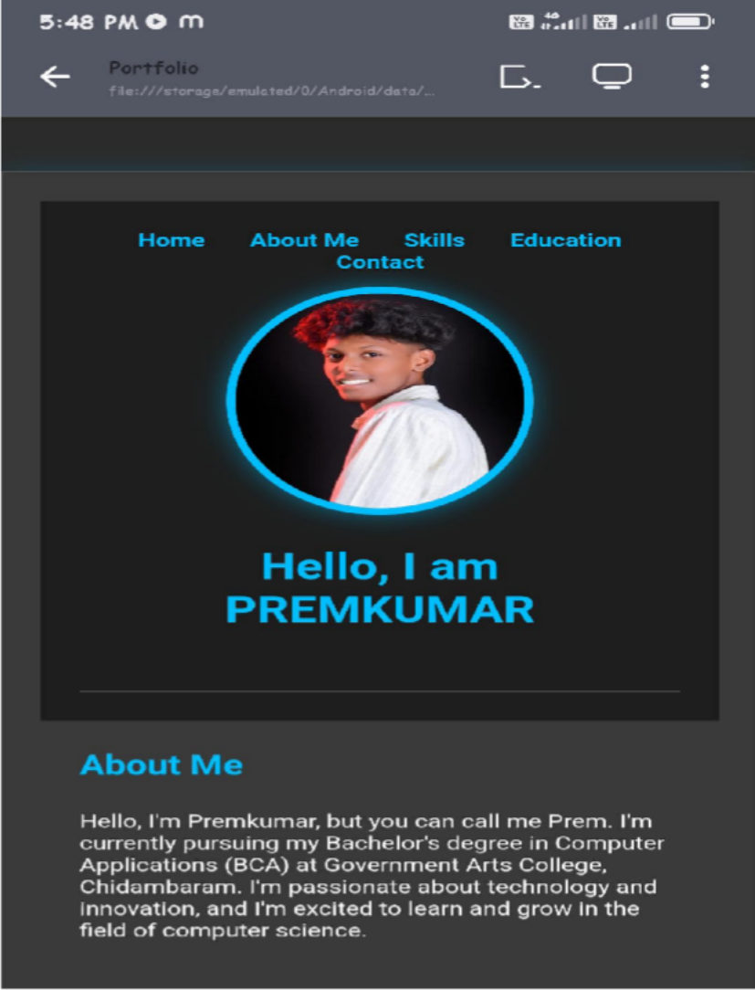
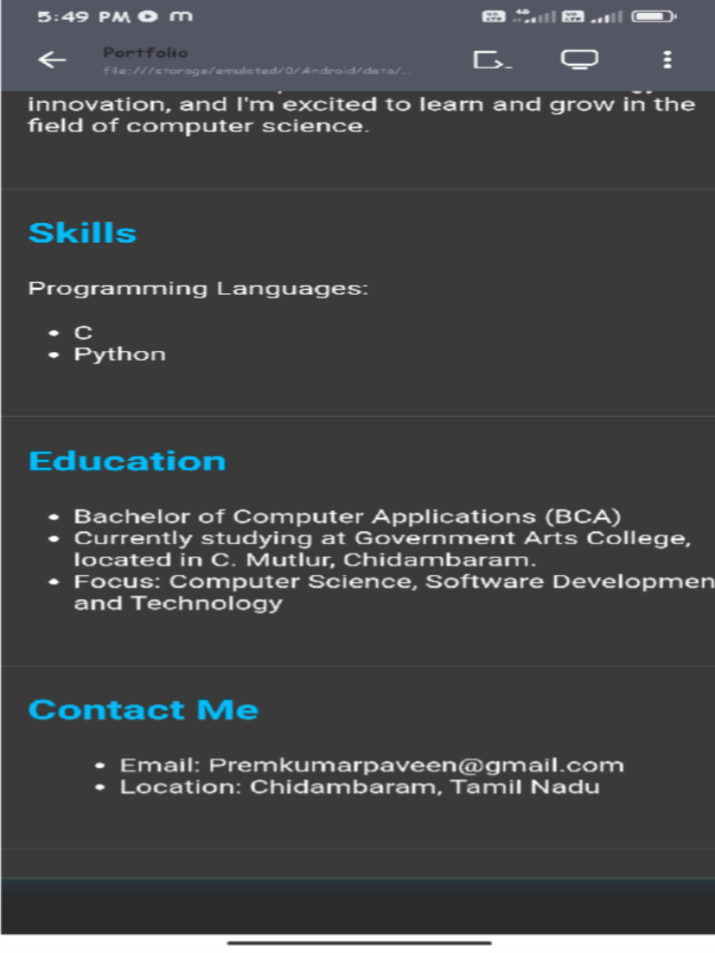
SCREENSHOT
S

Slide 10

CONCLUSION
This portfolio website reflects my technical knowledge and design ability. It not only acts as an online resume but also as a foundation for future projects where I can expand by adding new features such as a project gallery, blogs, or interactive elements. The project demonstrates that I can independently design and develop a functional website while following best practices of web development.

